Slide 1
JavaScript Events

Slide 2
JavaScript Events
The change in the state of an object is known as an Event. In html, there are various events which represents that some activity is performed by the user or by the browser.
When javascript code is included in HTML, js react over these events and allow the execution. This process of reacting over the events is called Event Handling. Thus, js handles the HTML events via Event Handlers.
For example, when a user clicks over the browser, add js code, which will execute the task to be performed on the event.
Some of the HTML events and their event handlers are:

Slide 3
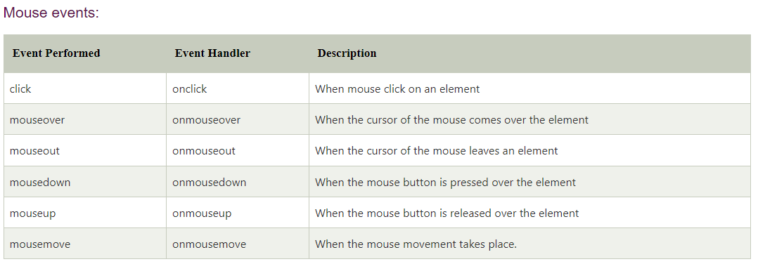
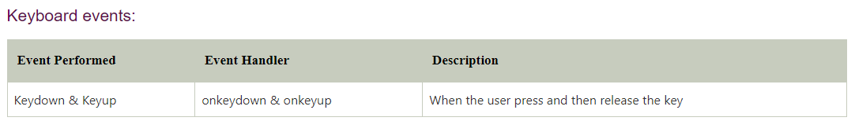

Slide 4
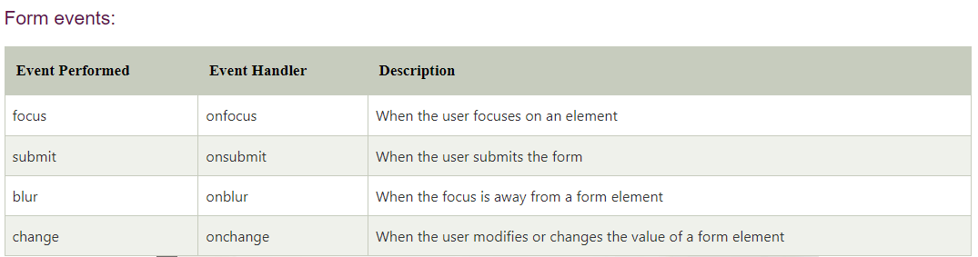
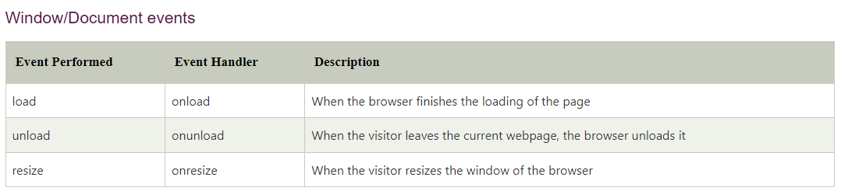

Slide 5
Click Event
<html>
<head> Javascript Events </head>
<body>
<script language="Javascript" type="text/Javascript">
<!--
function clickevent()
{
document.write("This is JavaTpoint");
}
//-->
</script>
<form>
<input type="button" onclick="clickevent()" value="Who's this?"/>
</form>
</body>
</html>

Slide 6
MouseOver Event
<html>
<head>
<h1> Javascript Events </h1>
</head>
<body>
<script language="Javascript" type="text/Javascript">
<!--
function mouseoverevent()
{
alert("This is JavaTpoint");
}
//-->
</script>
<p onmouseover="mouseoverevent()"> Keep cursor over me</p>
</body>
</html>

Slide 7
Focus Event
<html>
<head> Javascript Events</head>
<body>
<h2> Enter something here</h2>
<input type="text" id="input1" onfocus="focusevent()"/>
<script>
<!--
function focusevent()
{
document.getElementById("input1").style.background=" aqua";
}
//-->
</script>
</body>
</html>

Slide 8
Keydown Event
<html>
<head> Javascript Events</head>
<body>
<h2> Enter something here</h2>
<input type="text" id="input1" onkeydown="keydownevent()"/>
<script>
<!--
function keydownevent()
{
document.getElementById("input1");
alert("Pressed a key");
}
//-->
</script>
</body>
</html>

Slide 9
Load event
<html>
<head>Javascript Events</head>
</br>
<body onload="window.alert('Page successfully loaded');">
<script>
<!--
document.write("The page is loaded successfully");
//-->
</script>
</body>
</html>

Slide 10
JavaScript dblclick event
The dblclick event generates an event on double click the element. The event fires when an element is clicked twice in a very short span of time.
<body>
<h1 id = "heading" ondblclick = "fun()"> Hello world :):) </h1>
<h2> Double Click the text "Hello world" to see the effect. </h2>
<p> This is an example of using the <b> ondblclick </b> attribute. </p>
<script>
function fun() {
document.getElementById("heading").innerHTML = " Welcome to the javaTpoint.com ";
}
</script>
</body>

Slide 11
JavaScript onload
In JavaScript, this event can apply to launch a particular function when the page is fully displayed.
In HTML, the onload attribute is generally used with the <body> element to execute a script once the content (including CSS files, images, scripts, etc.) of the webpage is completely loaded. It is not necessary to use it only with <body> tag, as it can be used with other HTML elements.
The difference between the document.onload and window.onload is: document.onload triggers before the loading of images and other external content. It is fired before the window.onload. While the window.onload triggers when the entire page loads, including CSS files, script files, images, etc.

Slide 12
Example
In this example, there is a div element with a height of 200px and a width of 200px. Here, we are using the window.onload() to change the background color, width, and height of the div element after loading the web page.
<style type = "text/css">
#bg{
width: 200px;
height: 200px;
border: 4px solid blue;
}
</style>
<script type = "text/javascript">
window.onload = function(){
document.getElementById("bg").style.backgroundColor = "red";
document.getElementById("bg").style.width = "300px";
document.getElementById("bg").style.height = "300px";
}
</script>
<body>
<h2> This is an example of window.onload() </h2>
<div id = "bg"></div>
</body>

